Slide 1
Comparison of KNN and SVM on Synthetic Dataset
Classification Algorithms – From Scratch Implementation
Name: Siddhi – G37 AI & ML

Slide 2
Introduction
Machine learning is used to classify data into different categories based on given features. K-Nearest Neighbors (KNN) and Support Vector Machine (SVM) are two commonly used classification algorithms. KNN classifies data based on the nearest neighbors, while SVM separates classes by creating a decision boundary. In this experiment, both algorithms are applied to a synthetic overlapping dataset and their performance is compared using accuracy.
KNN (K-Nearest Neighbors)
No training phase is required.
Classification depends on K nearest data points.
Uses distance measures like Euclidean distance.
Performance depends on correct choice of K value.
Sensitive to noise and overlapping data.
SVM (Support Vector Machine)
Finds an optimal decision boundary.
Maximizes the margin between classes.
Uses only support vectors for decision making.

Slide 3
Dataset Description
The dataset used in this is a synthetic dataset that has been created specifically for understanding the working of classification algorithms. Synthetic data allows better control over data distribution and helps in analyzing algorithm behavior clearly. The dataset consists of two different classes, namely Class 0 and Class 1, which represent two separate categories used for classification.
The data points are generated using random values, which results in a scattered distribution of points across the feature space. Due to this random generation, the data points belonging to both classes are not clearly separable. Instead of forming distinct clusters, many points from Class 0 and Class 1 are mixed with each other, creating an overlapping region between the two classes.
Some data points lie very close to the decision boundary, which increases the difficulty of the classification task. These boundary points can easily be misclassified, especially when the dataset is noisy or overlapping. Because of this, perfect classification accuracy cannot be achieved for this dataset.
Such an overlapping synthetic dataset closely resembles real-world scenarios, where data is often imperfect and classes are not well separated. This makes the dataset suitable for evaluating the true performance and robustness of classification algorithms like KNN and SVM.

Slide 4
KNN (K-Nearest Neighbors) – Working
K-Nearest Neighbors is a simple supervised machine learning algorithm used for classification. It works based on the idea that similar data points exist close to each other. KNN does not require a training phase and makes predictions using the training data itself.
Working Steps:
Select the value of K (number of neighbors)
Calculate the distance between the test point and all training points
Sort the distances in ascending order
Choose the K nearest neighbors
Perform majority voting
Assign the class with maximum votes to the test point
Because the dataset is overlapping, some nearest neighbors may belong to different classes, which can lead to misclassification.

Slide 5
SVM(Support Vector Machine)Working
Support Vector Machine (SVM) is a supervised learning algorithm used for classification. It works by finding a decision boundary that separates different classes. The main objective of SVM is to create a boundary that maximizes the distance between the nearest data points of both classes.
Working Steps:
Convert class labels into numerical values
Find a separating line (decision boundary) between classes
Identify the closest data points called support vectors
Maximize the margin between the classes
Classify new data based on which side of the boundary it lies
SVM performs well on overlapping data because it focuses on the most important boundary points rather than all data points.

Slide 6
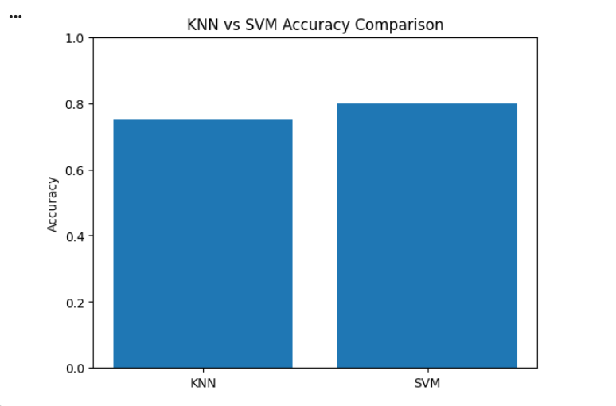
Results and Accuracy
Both KNN and SVM algorithms were applied to the synthetic overlapping dataset and their performance was evaluated using accuracy. Since the dataset contains overlapping classes, achieving perfect accuracy is not possible. The obtained accuracy values represent realistic model performance on such data.
Results Obtained:
  KNN Accuracy: 0.75
  SVM Accuracy: 0.80
  SVM shows higher accuracy compared to KNN because it learns a global decision boundary and maximizes the margin between classes, while KNN depends on local neighbors which can be affected by overlapping points.

Slide 7
Conclusion
From this results, it is clear that both KNN and SVM have their own strengths and limitations. KNN is easy to understand and implement, making it suitable for small and simple datasets, but its performance decreases when data is noisy or overlapping. SVM, on the other hand, handles overlapping and complex data more effectively by focusing on the most critical boundary points and maximizing the margin between classes. The higher accuracy obtained by SVM in this experiment shows that it is more reliable and efficient for realistic datasets where perfect separation is not possible. Therefore, SVM is a better choice than KNN for classification tasks involving overlapping data.

Slide 8
Thank You!!!!

